Slide 1
RL-Trade
An Experiment on Apply Deep Reinforcement Learning to train Equity Trading Agent
By Zhongheng Li
For CSCI E-89 Section 2 (25792) – Deep Learning

Slide 2
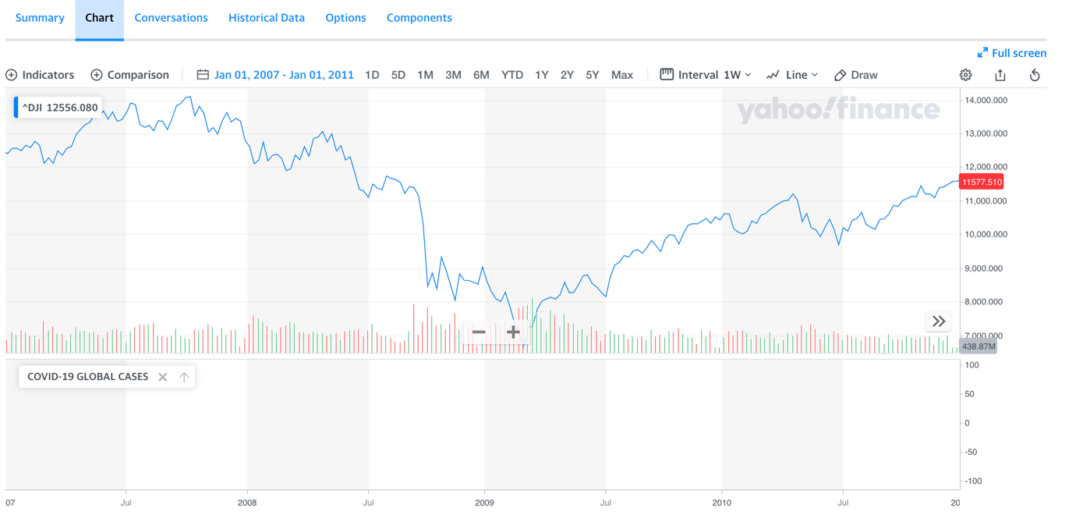
Problem Statement
In late 2008, the stock market crashed due to the Subprime Mortgage Crisis
The machine learning technologies back then were not as advanced and not as accessible as now in 2020

Slide 3
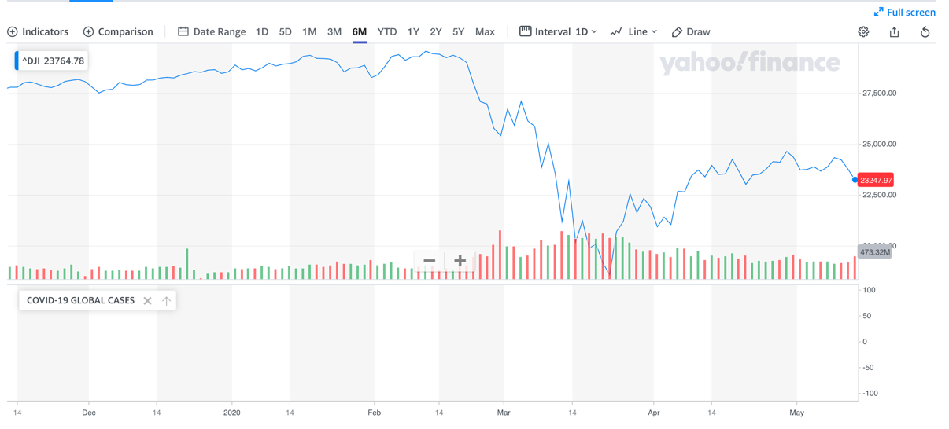
Problem Statement
As in 2020, humanity is facing an unprecedented crisis that due to the COVID-19
For economy alone. We are facing a much more serious financial crisis at global scale

Slide 4
Problem Statement
As in 2020, more than a decade after the last financial crisis, with many AI breakthroughs in recent years, can we leverage machine learning to assist us to get over the on going financial gap?
Can we leverage AI agent as an assistant to help us to hop over the financial gap year(s)?
Disclaimer – this project is simply an experiment to explore the feasibilities for apply machine learning in finance. There are many fin-techs and big financial companies are already doing this sim2real approach
For example JP Morgan’s ML trading on Foreign Exchange

Slide 5
Why Reinforcement Learning?
Traditional timeseries analysis and predative approaches are deterministic and bounded by historical data
Basically turned it into a supervised learning problem
However, in the real world, there are many factors that can create too many uncertainties. It is better to take the RL approach

Slide 6
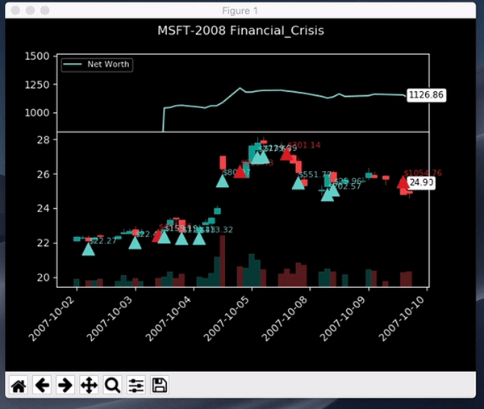
The Agent Training Environment – The Gym
Utilizing a very simple Stock Market OpenAI Gym based environment that create by Adam King.
Adam is one of the key contributor of the large scale RL trading framework Tensortrade
This is GIF to visualize how my trained agent is navigating the 08 Financial Crisis in the MSFT stock space

Slide 7
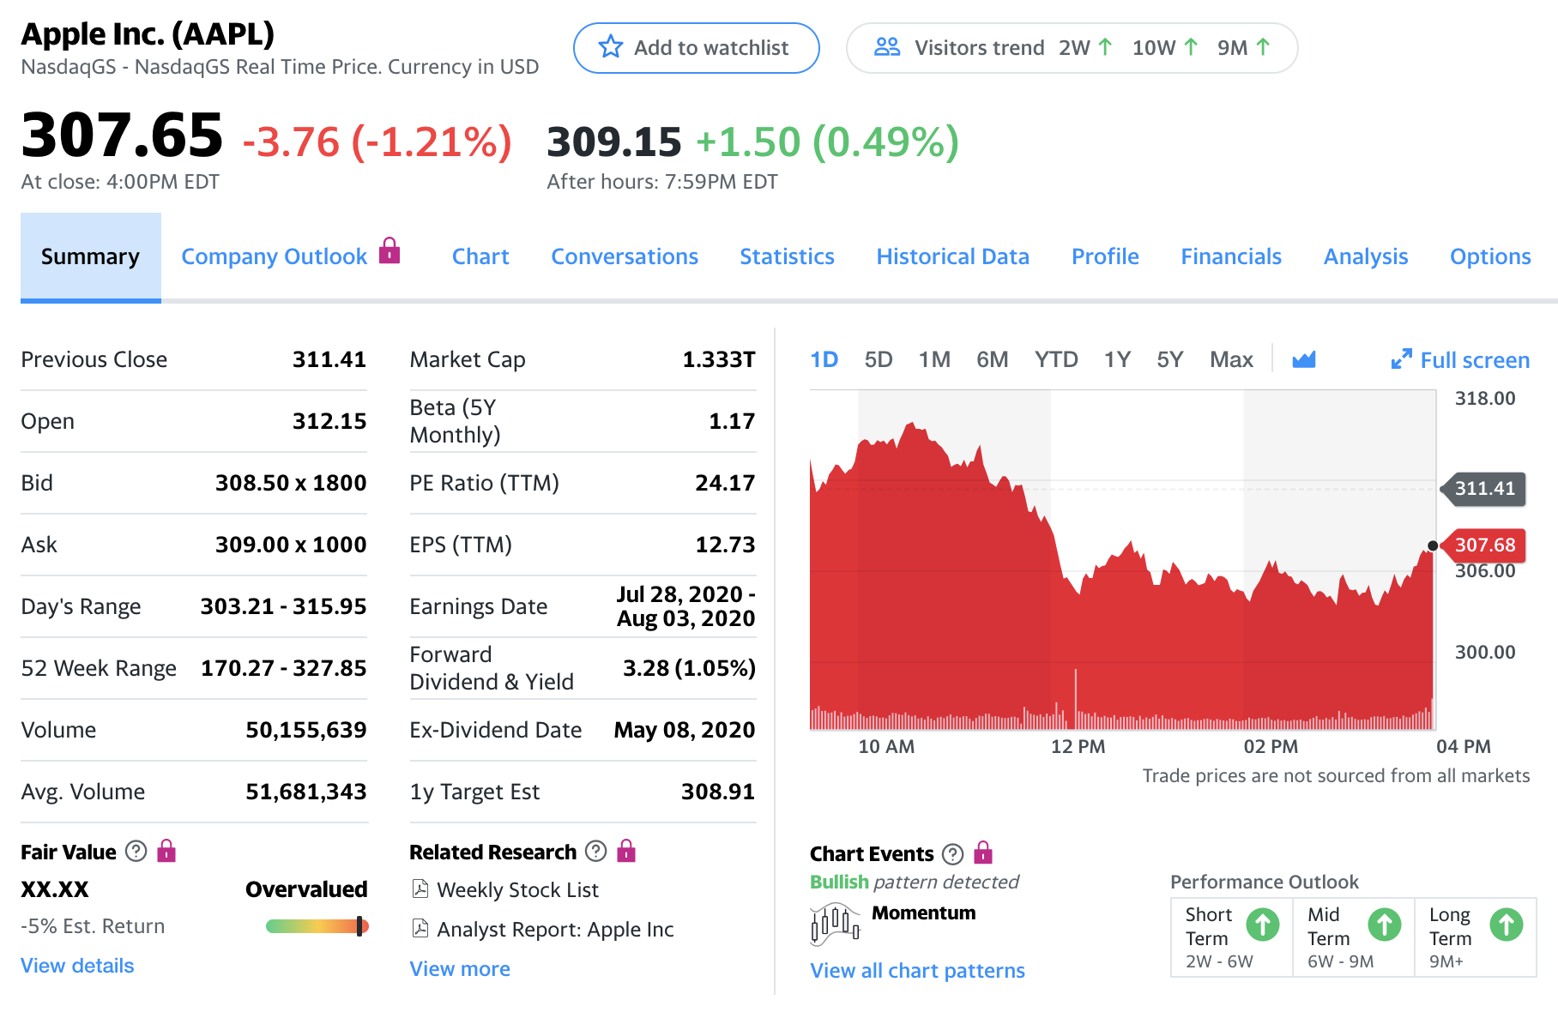
Data Source
Data from Yahoo Finance. Daily stock Open, High, Low, Close, Volume (OHLCV) data from May 1998 to May 2020 for the following 2 stocks:
Apple
Microsoft

Slide 8
Exploratory Data Analysis – Training Data
The overall close price trajectory of MSFT (1998 -2020)
The overall close price trajectory of AAPL (1998 -2020)

Slide 9
Exploratory Data Analysis – Testing Data
The overall close price trajectory of MSFT (Sep 07 – Sep 09)
The overall close price trajectory of AAPL (Sep 07 – Sep 09)

Slide 10
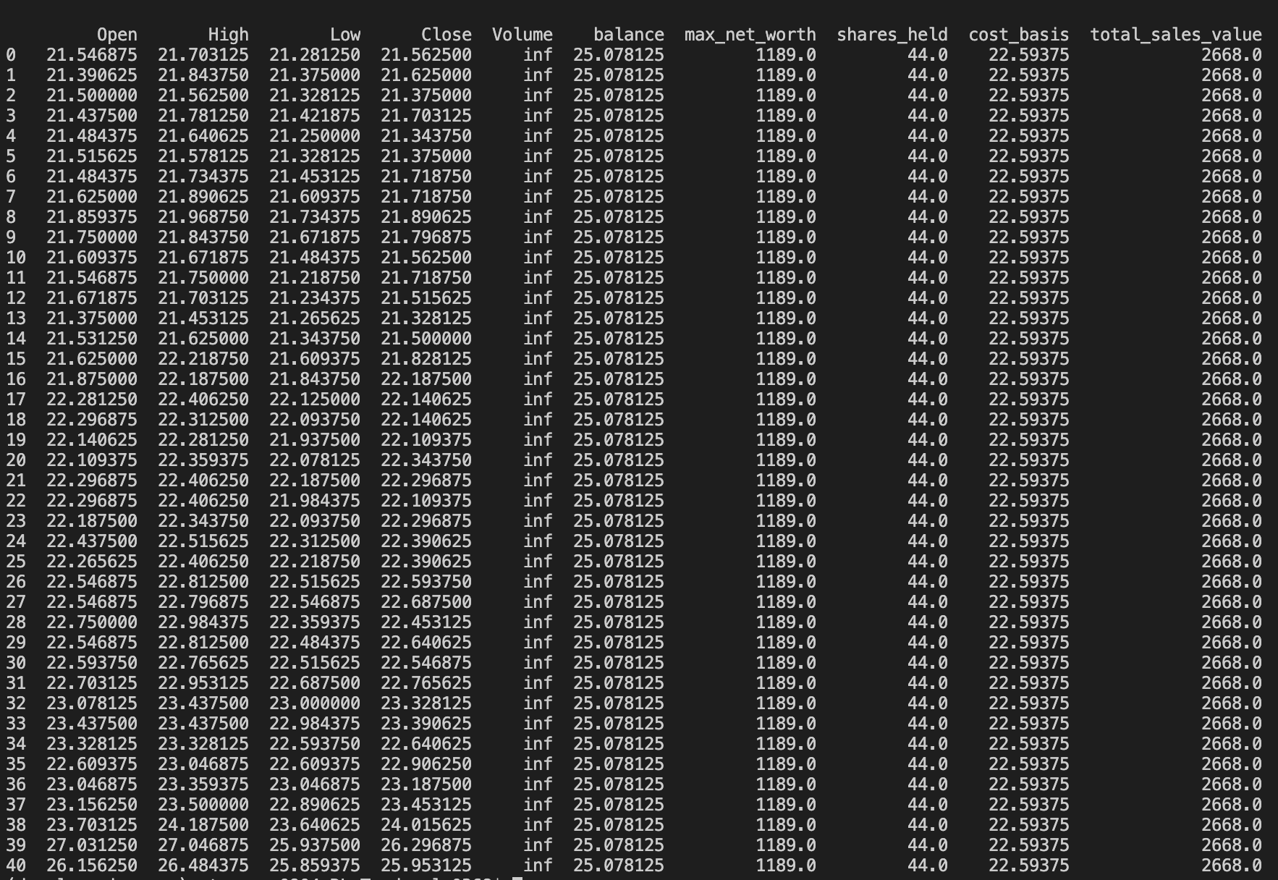
Data as Observation Apace
In each time step per day, the environment will provide the following data as observation for the agent to determine the action to be taken for the next time step:

Slide 11
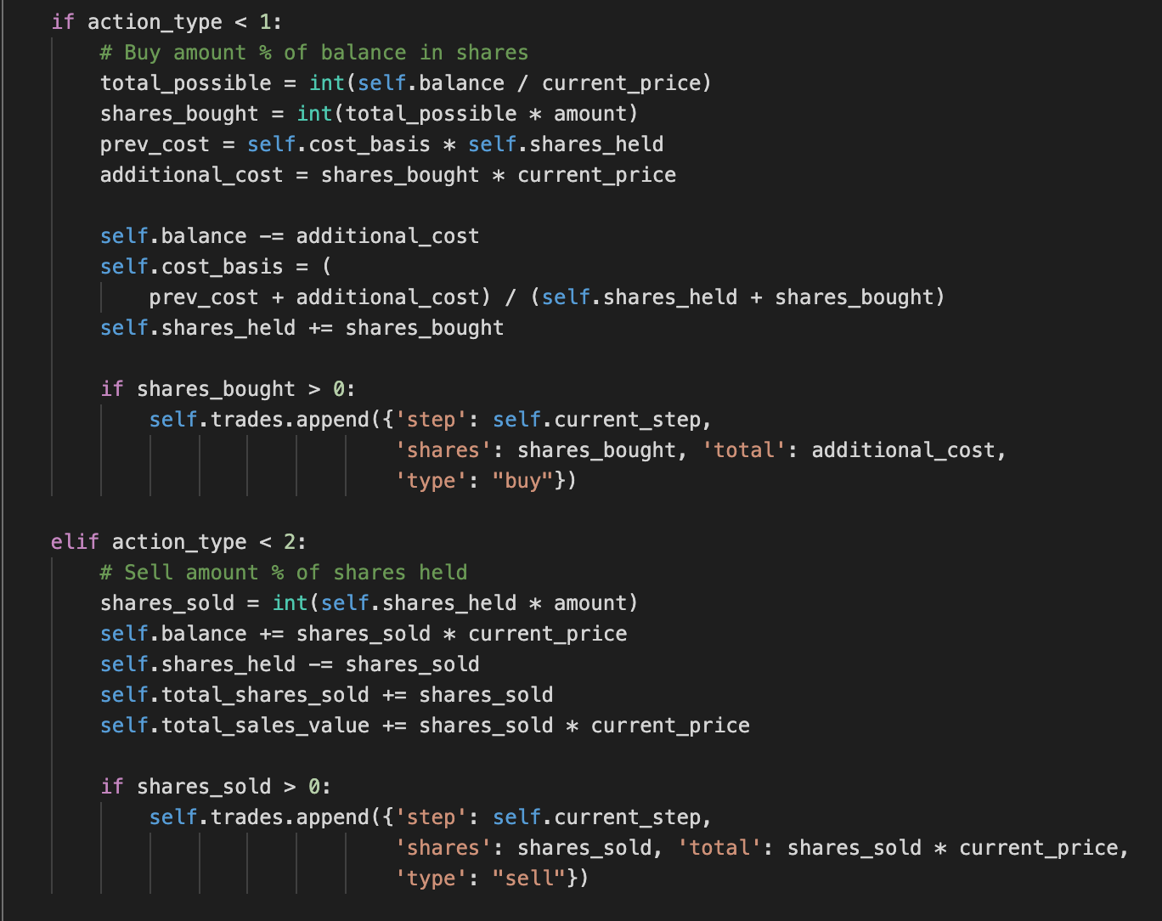

Data as Action Apace
The action space is included in the environment, it is designed based on a ReLu function.
There 3 actions to take: Buy, Sell and Hold (Do nothing)
The choices are discrete, but the output does provide continuous factor which make this problem a semi-continuous problem.
Sample action: [[1.245 0.07687 ]]
Blue is the action type value
Green is the number of shares based on the
percentage of current account balance to buy or sell

Slide 12
Data as Action Apace - Example
action: [[0.05176, 0.991]]
Step: 45
Trading Date: 2007-10-22
Balance: 479.8368544771603
Shares held: 24 (Total sold: 124)
Avg cost for held shares: 22.478971695626672 (Total sales value: 2667.998947759153)
Net worth: 1024.7359215170877 (Max net worth: 1042.0290971997606)
Action: [0, 0]
Reward: 24.91586033751665
Profit: 24.735921517087718
Step: 46
Trading Date: 2007-10-23
Balance: 25.081674733842306
Shares held: 44 (Total sold: 124)
Avg cost for held shares: 22.596602282689958 (Total sales value: 2667.998947759153)
Net worth: 1025.5430701691416 (Max net worth: 1042.0290971997606)
Action: [0.05176 0.991 ]
Reward: 25.552684811122937
Profit: 25.54307016914163

Slide 13
Data as Rewards
reward = balance * delay_modifier + profit - (cur_trial_step * (balance * INFLATION_RATE))
INFLATION_RATE = (0.015 / 360)

Slide 14
Approach 1 – Semi Continuous Deep Q-Network (DQN)
Our problem is a semi continuous problem. We do have discrete actions: Buy. Sell and Hold. But we also have continuous number of shares we can buy/sell
DQN is not suitable for continuous problems. But as for our semi continuous problem we started with DQN
My SC-DQN implementation is built on top of this open source reference by Yash Patel

Slide 15
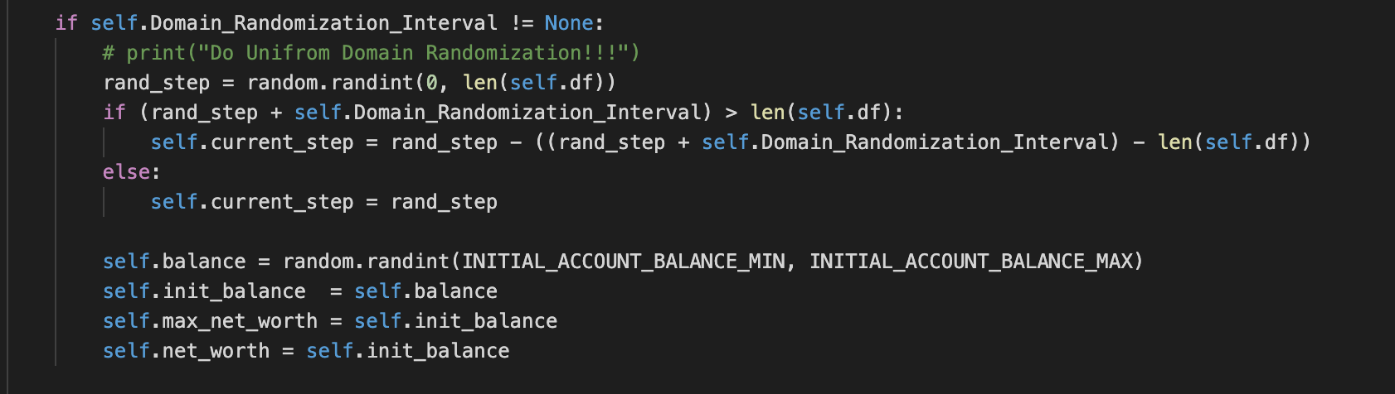
Data Augmentation with Domain Randomization
To ensure the sim2real, and let our agent to experiencing different enviorment as much as possible during trainining, I applied Uniform Domain Randomization that proposed by this paper Domain Randomization for Transferring Deep Neural Networks from Simulation to the Real World, to randomized the agent’s starting balance, starting date and more.

Slide 16
Approach 1 – SC-DQN with LSTM
Our problem is a semi continuous problem. We do have discrete actions: Buy. Sell and Hold. But we also have continuous number of shares we can buy/sell
I utilized the LSTM as the main architecture for our agent’s action prediction model

Slide 17
Approach 1 – SC-DQN - Results

Slide 18
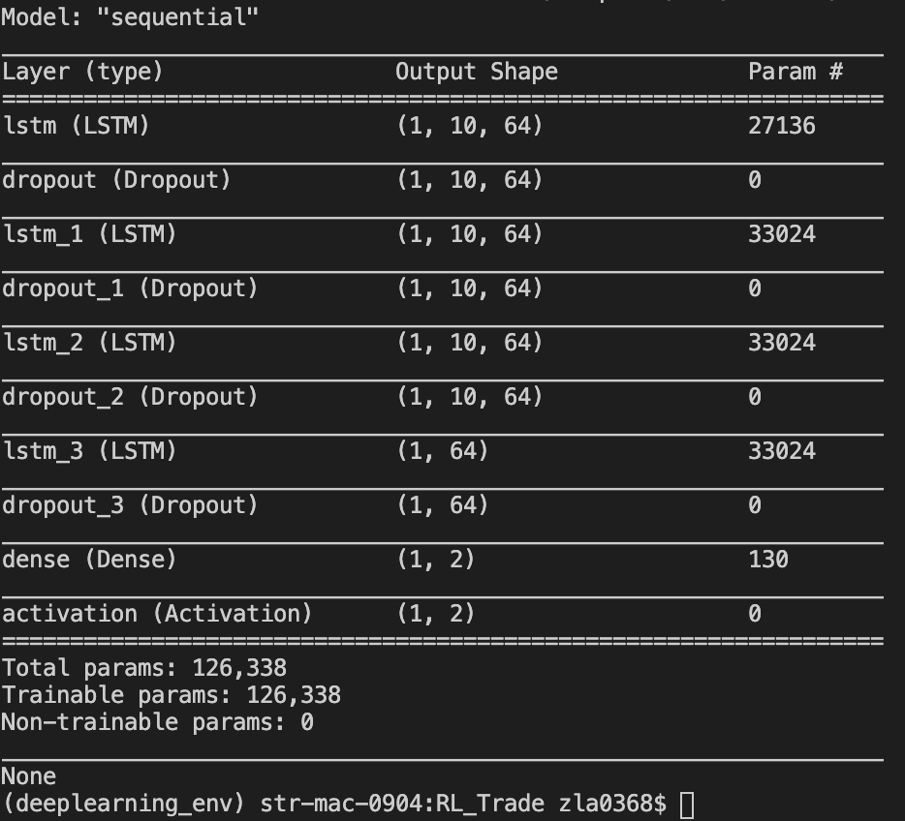
Approach 1 v2 – DQN with LSTM
Our problem is a semi continuous problem. We do have discrete actions: Buy. Sell and Hold. But we also have continuous number of shares we can buy/sell
I utilized the LSTM as the main architecture for our agent’s action prediction model with more layers

Slide 19
Approach 1 v2 – DQN with LSTM - Results

Slide 20
Approach 1 v2 – DQN with LSTM + UDR - Results

Slide 21
Approach 1 v2 – DQN with LSTM Transfer Learning
Transfer learning from learning with Microsoft data to Apple data

Slide 22
Approach 1 v2 – DQN with LSTM Transfer Learning
Transfer learning from learning with Microsoft data to Apple data

Slide 23
Approach 1 v2 – DQN with LSTM Transfer Learning
Transfer learning from learning with Microsoft data to Apple data

Slide 24
Approach 2 – Actor-critic model
Try out a real continuous 2 input duel model approach

Slide 25
Approach 2 – Actor-critic model - Results

Slide 26
Future Works – Actor-critic model with LSTM and more

Slide 27
Future Works – con
Work with COVID data for penalty and rewards on training policies

Slide 28
Summary
This experiment shows there is still a lot of factors to train and affect the agent’s performance. As you can see from the right. Not all the runs with the same agents can produce consistent outputs due to the model is still basically relying on the random sampling action that determine by the epsilon, even with lower epsilon during testing.
Other works:
Heavily enhanced the StockMarket Gym Env
Try out different deep RL models
Modify the code from TF1 to TF2
https://github.com/heng2j/RL-Trade

